Slide 1

Domain Name System
E-Mail
SNMP
FTP
Network Configuration Protocol

Slide 2

Figure 25.1 Example of using the DNS service
25.<number>

Slide 3
25-1 NAME SPACE
To be unambiguous, the names assigned to machines must be carefully selected from a name space with complete control over the binding between the names and IP addresses.
Topics discussed in this section:
Flat Name Space
Hierarchical Name Space
25.<number>

Slide 4
25-2 DOMAIN NAME SPACE
To have a hierarchical name space, a domain name space was designed. In this design the names are defined in an inverted-tree structure with the root at the top. The tree can have only 128 levels: level 0 (root) to level 127.
Topics discussed in this section:
Label
Domain Name
Domain
25.<number>

Slide 5

Figure 25.2 Domain name space
25.<number>

Slide 6

Figure 25.3 Domain names and labels
25.<number>

Slide 7
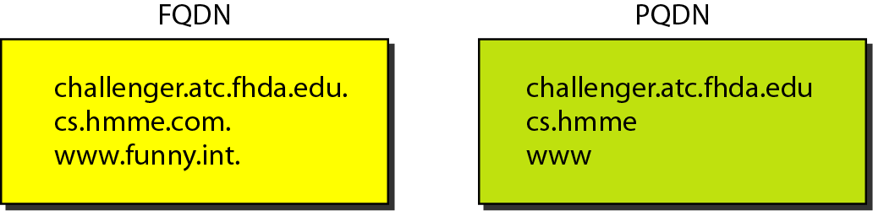
Figure 25.4 FQDN (Fully Qualified domain name) and
PQDN (Partially Qualified domain name)
25.<number>

Slide 8

Figure 25.5 Domains
25.<number>

Slide 9
25-4 DNS IN THE INTERNET
DNS is a protocol that can be used in different platforms. In the Internet, the domain name space (tree) is divided into three different sections: generic domains, country domains, and the inverse domain.
Topics discussed in this section:
Generic Domains
Country Domains
Inverse Domain
25.<number>

Slide 10

Figure 25.8 DNS IN THE INTERNET
25.<number>

Slide 11

Figure 25.9 Generic domains
25.<number>

Slide 12

Table 25.1 Generic domain labels
25.<number>

Slide 13
26-2 ELECTRONIC MAIL
One of the most popular Internet services is electronic mail (e-mail). The designers of the Internet probably never imagined the popularity of this application program. Its architecture consists of several components that we discuss in this chapter.
Topics discussed in this section:
Architecture
User Agent
Message Transfer Agent: SMTP
Message Access Agent: POP and IMAP
Web-Based Mail
26.<number>

Slide 14

Figure 26.6 First scenario in electronic mail
26.<number>

Slide 15

Note
When the sender and the receiver of an e-mail are on the same system,
we need only two user agents.
26.<number>

Slide 16

Figure 26.7 Second scenario in electronic mail
26.<number>

Slide 17
Note
When the sender and the receiver of an e-mail are on different systems, we
need two UAs and a pair of
MTAs (client and server).
26.<number>

Slide 18

Figure 26.8 Third scenario in electronic mail
26.<number>

Slide 19
Note
When the sender is connected to the mail server via a LAN or a WAN,
we need two UAs and two pairs
of MTAs (client and server).
26.<number>

Slide 20

Figure 26.9 Fourth scenario in electronic mail
26.<number>

Slide 21

Figure 26.10 Push versus pull in electronic email
26.<number>

Slide 22

Figure 26.11 Services of user agent
26.<number>

Slide 23

Figure 26.12 Format of an e-mail
26.<number>

Slide 24

Figure 26.13 E-mail address
26.<number>

Slide 25
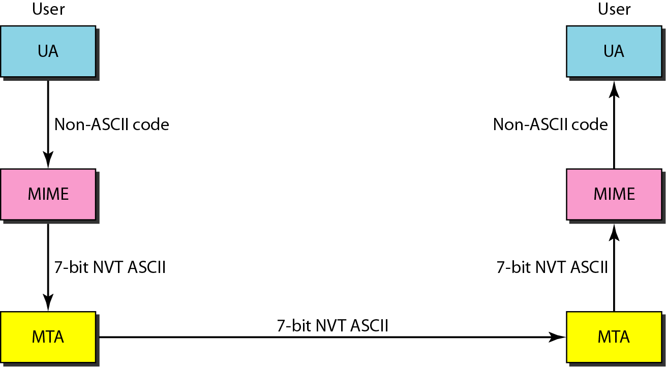
Figure 26.14 MIME (Multipurpose Internet Mail Extensions)
26.<number>

Slide 26
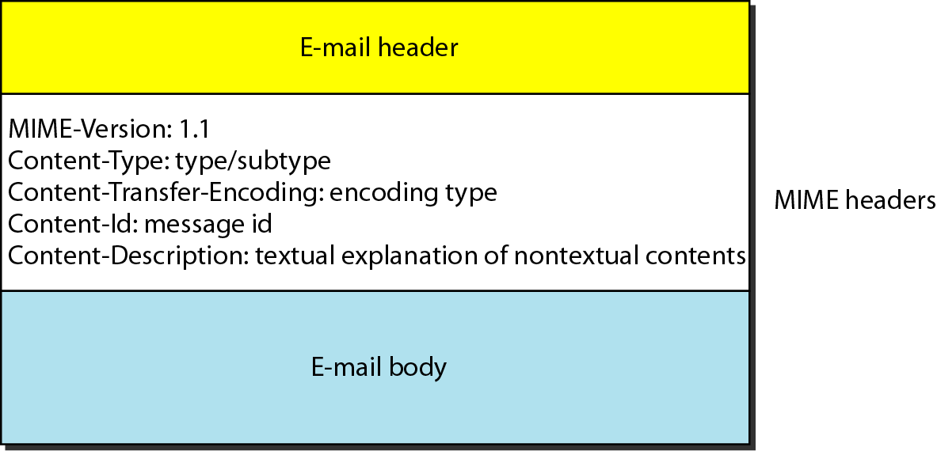
Figure 26.15 MIME header
26.<number>

Slide 27
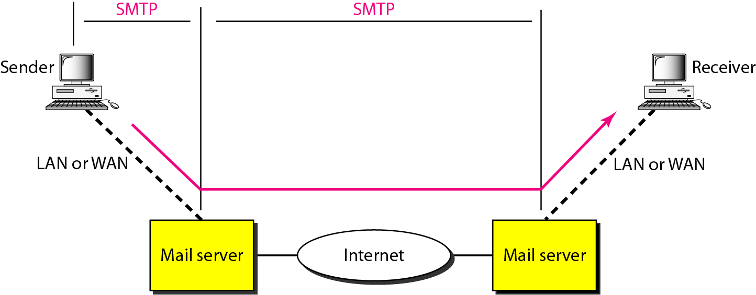
Figure 26.16 SMTP range
26.<number>

Slide 28

Figure 26.17 Commands and responses
26.<number>

Slide 29
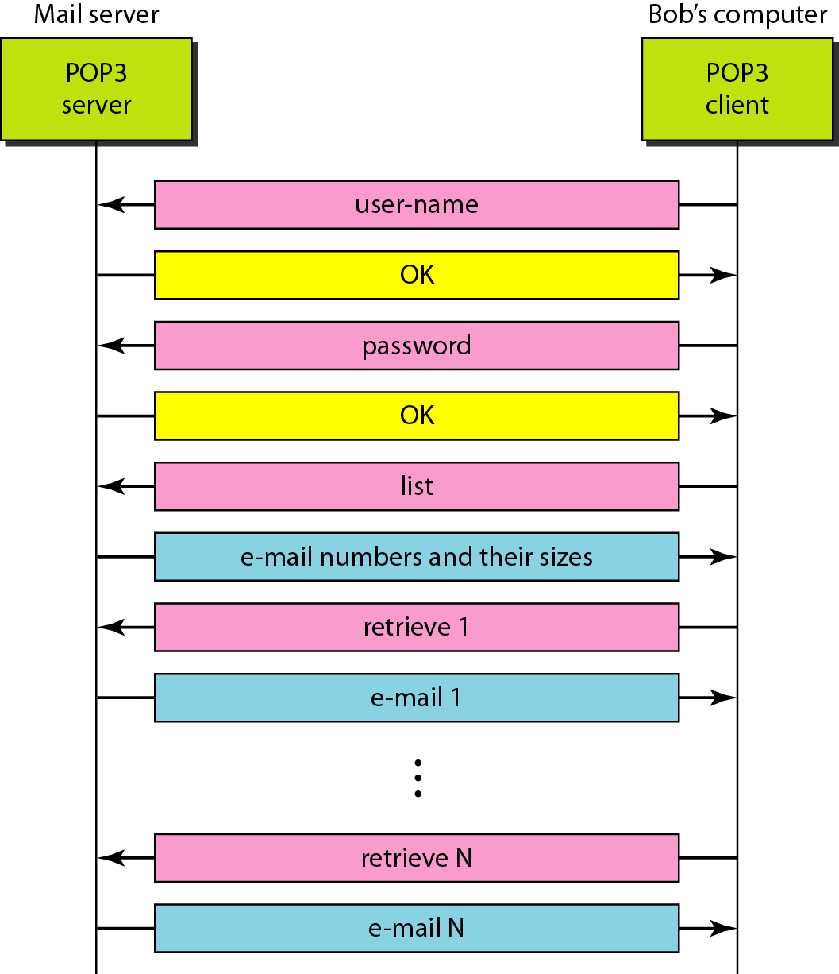
Figure 26.20 The exchange of commands and responses in POP3
26.<number>

Slide 30
28-2 SIMPLE NETWORK MANAGEMENT
PROTOCOL (SNMP)
The Simple Network Management Protocol (SNMP) is a framework for managing devices in an internet using the TCP/IP protocol suite. It provides a set of fundamental operations for monitoring and maintaining an internet.
Topics discussed in this section:
Concept
Management Components
Structure of Management Information (SMI)
Management Information Base (MIB)
SNMP
28.<number>

Slide 31
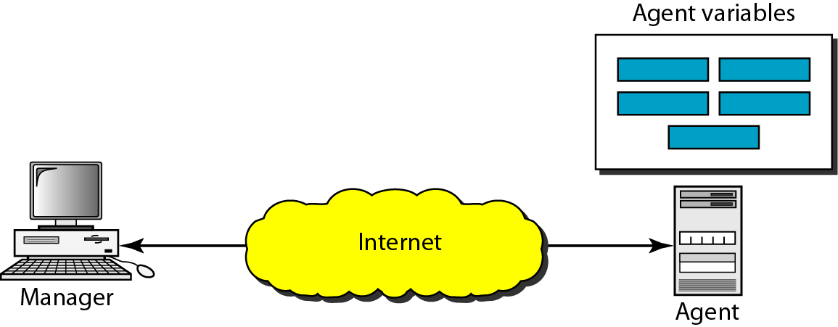
Figure 28.2 SNMP concept
28.<number>

Slide 32
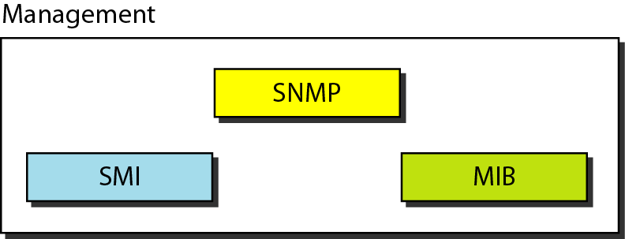
Figure 28.3 Components of network management on the Internet
SMI: Structure of Management Information
MIB: Management Information Base
28.<number>

Slide 33
Note
SNMP defines the format of packets exchanged between a manager and
an agent. It reads and changes the status (values) of objects (variables)
in SNMP packets.
28.<number>

Slide 34
Note
SMI defines the general rules for naming objects, defining object types (including
range and length), and showing how to encode objects and values. SMI does not define the number of objects an entity should manage or name the objects to be managed or define the association between the objects and their values.
28.<number>

Slide 35
Note
MIB creates a collection of named objects, their types, and their relationships to each other
in an entity to be managed.
28.<number>

Slide 36
Note
We can compare the task of network management to the task of writing a program.
❏ Both tasks need rules. In network
management this is handled by SMI.
❏ Both tasks need variable declarations. In
network management this is handled by MIB.
❏ Both tasks have actions performed by
statements. In network management this is
handled by SNMP.
28.<number>

Slide 37
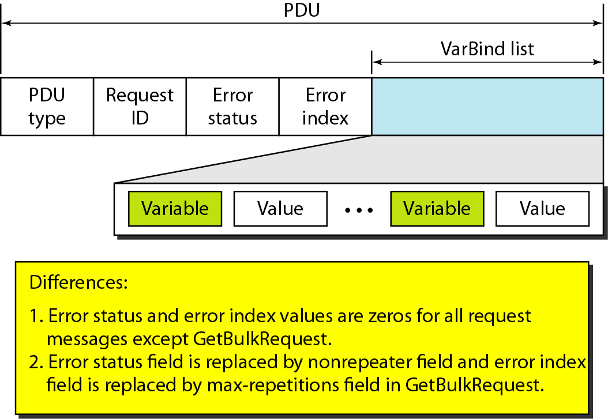
Figure 28.21 SNMP PDU format
28.<number>

Slide 38
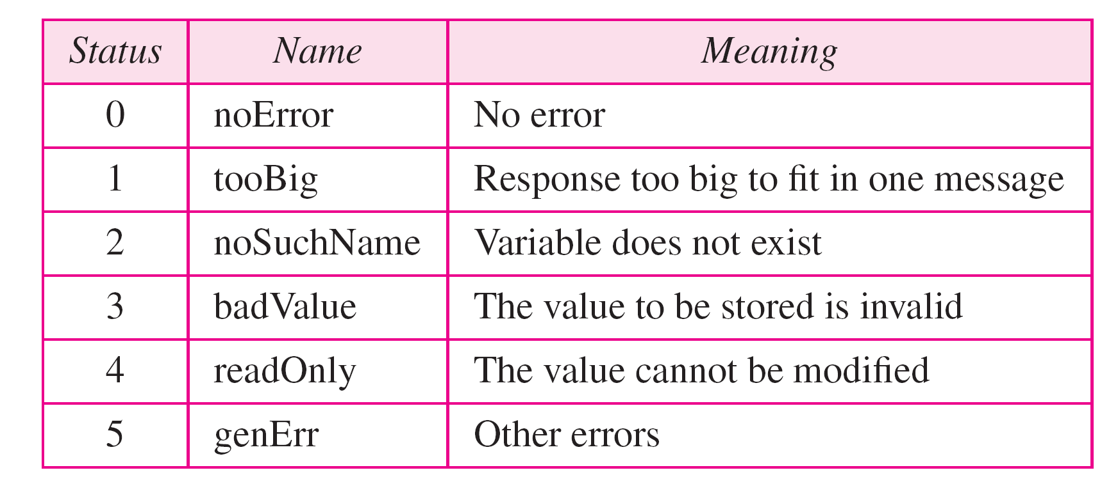
Table 28.3 Types of errors
28.<number>

Slide 39
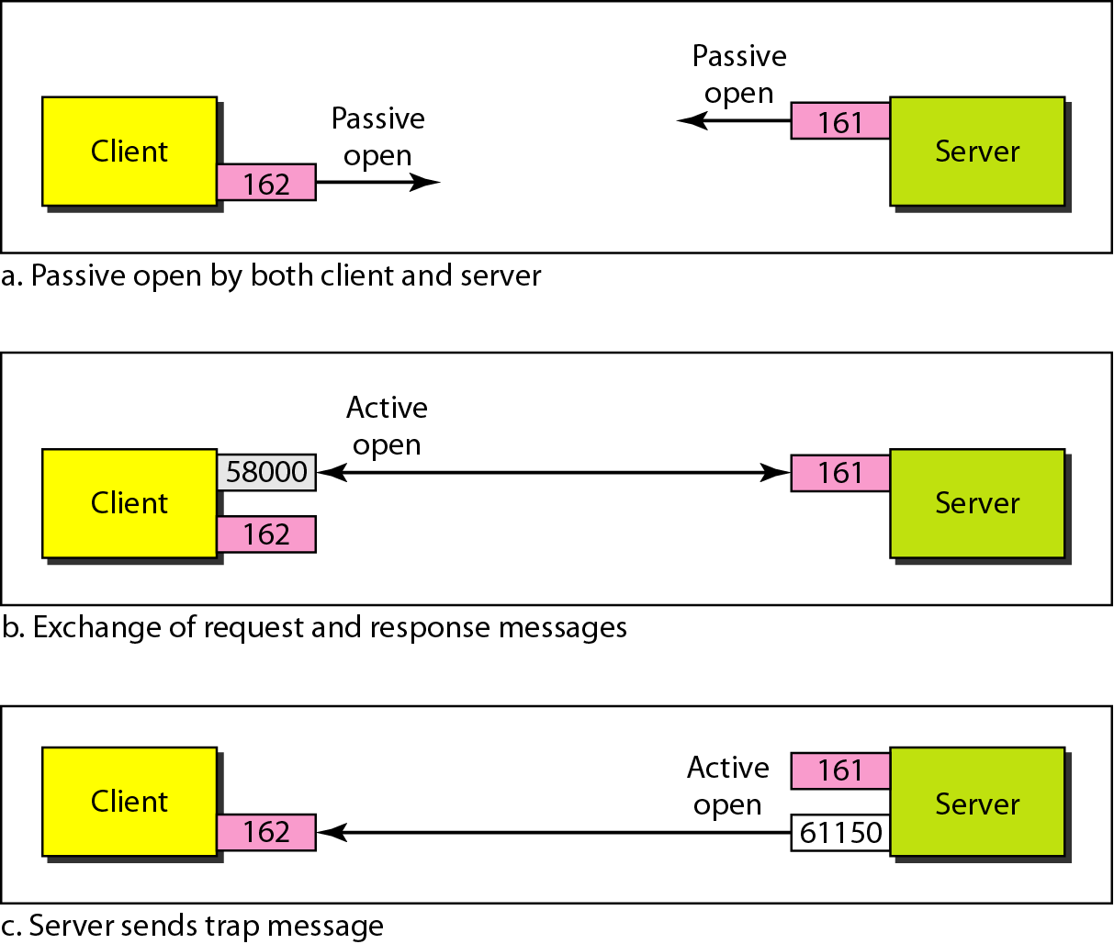
Figure 28.25 Port numbers for SNMP
28.<number>

Slide 40
26-3 FILE TRANSFER
Transferring files from one computer to another is one of the most common tasks expected from a networking or internetworking environment. As a matter of fact, the greatest volume of data exchange in the Internet today is due to file transfer.
Topics discussed in this section:
File Transfer Protocol (FTP)
Anonymous FTP
26.<number>

Slide 41
Note
FTP uses the services of TCP. It needs two TCP connections.
The well-known port 21 is used for the control connection and the well-known port 20 for the data connection.
26.<number>

Slide 42
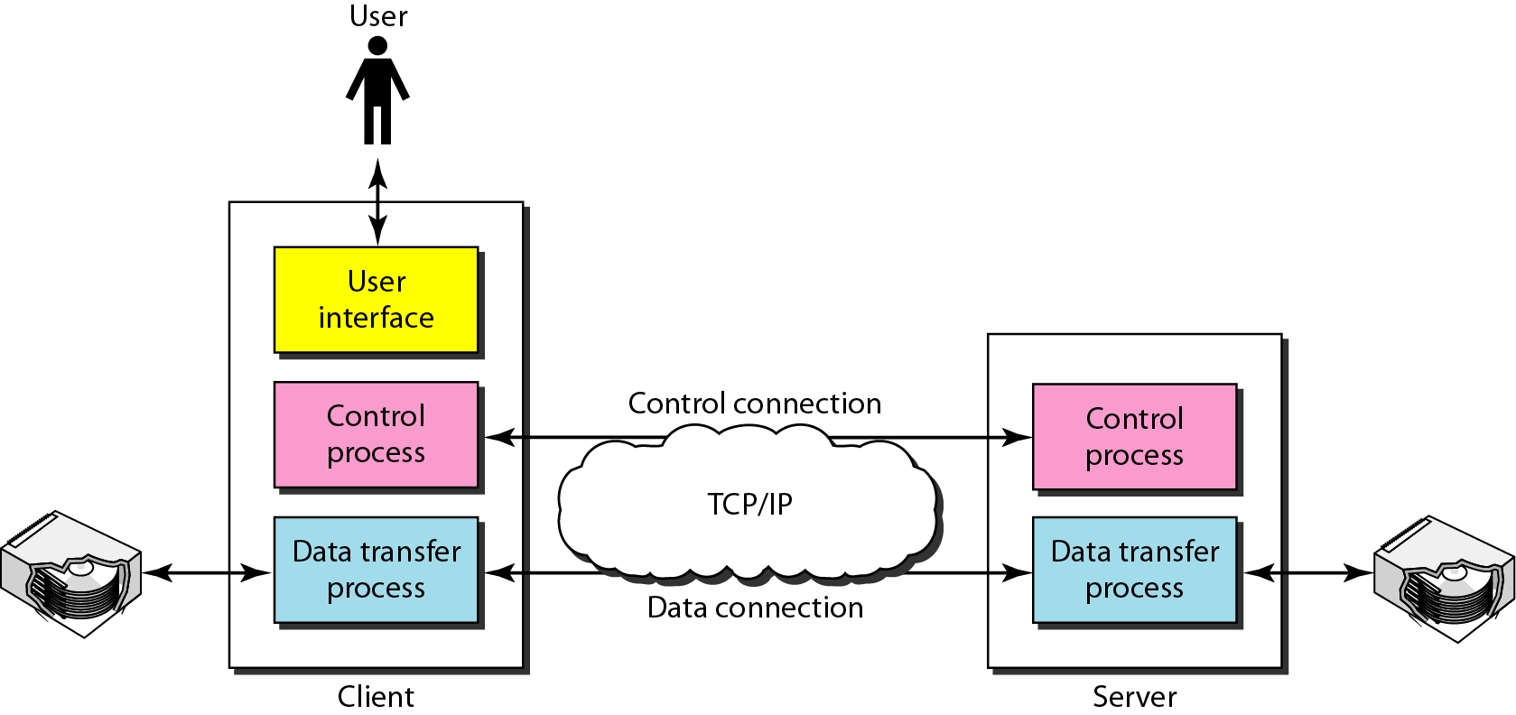
Figure 26.21 FTP
26.<number>

Slide 43
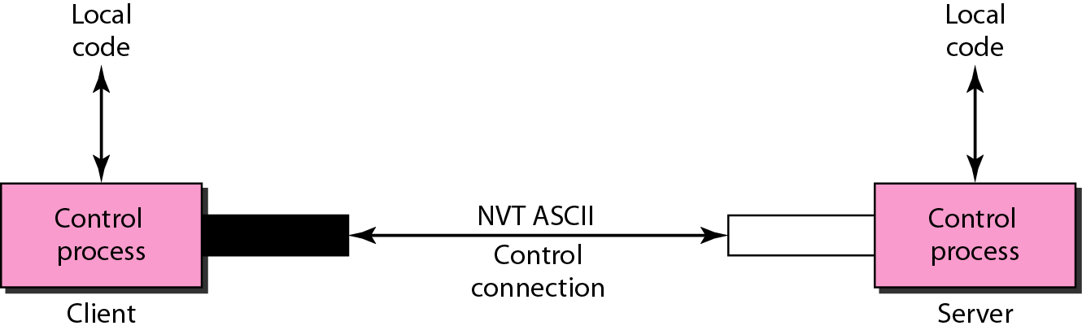
Figure 26.22 Using the control connection
26.<number>

Slide 44
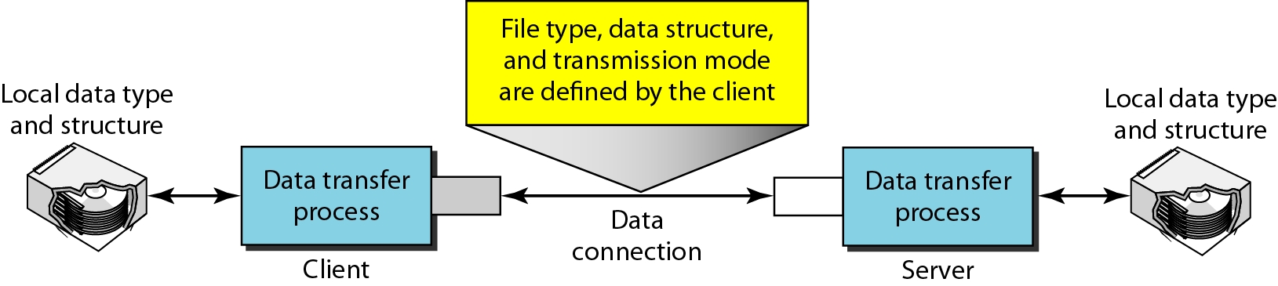
Figure 26.23 Using the data connection
26.<number>

Slide 45
Example 26.4
The following shows an actual FTP session for retrieving a list of items in a directory. The colored lines show the responses from the server control connection; the black lines show the commands sent by the client. The lines in white with a black background show data transfer.
1. After the control connection is created, the FTP server
sends the 220 response.
2. The client sends its name.
3. The server responds with 331.
26.<number>

Slide 46
Example 26.4 (continued)
4. The client sends the password (not shown).
5. The server responds with 230 (user log-in is OK).
6. The client sends the list command (ls reports) to find
the list of files on the directory named report.
7. Now the server responds with 150 and opens the data
connection.
8. The server then sends the list of the files or directories
on the data connection.
9. The client sends a QUIT command.
10. The server responds with 221.
26.<number>

Slide 47
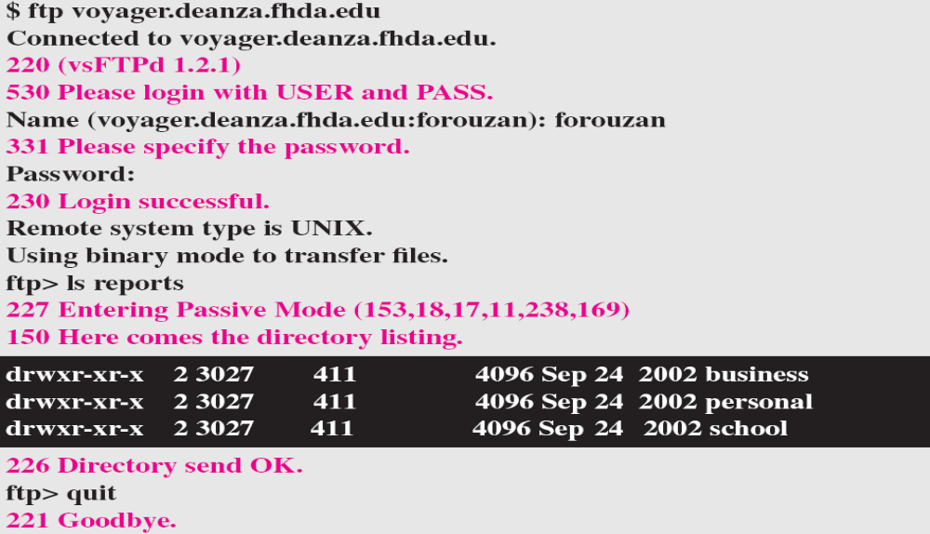
Example 26.4 (continued)
26.<number>

Slide 48
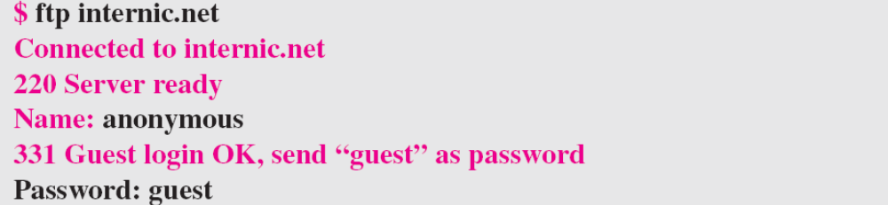
Example 26.5
We show an example of anonymous FTP. We assume that some public data are available at internic.net.
We show an example of anonymous FTP. We assume that some public data are available at internic.net.
continued on next slide
26.<number>

Slide 49
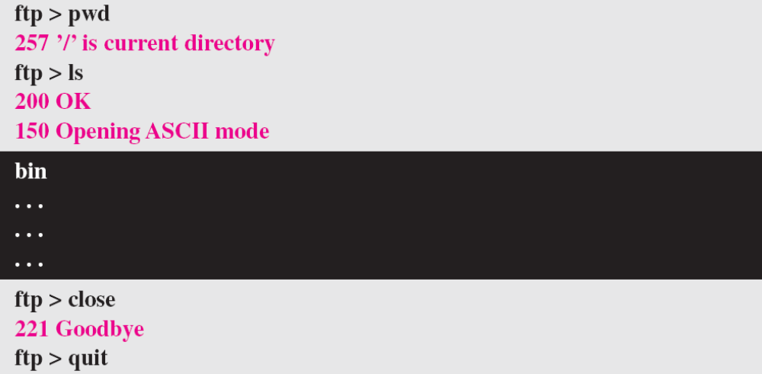
Example 26.5 (continued)
26.<number>

Slide 50
Network Configuration Protocol
Network Configuration Protocol (NETCONF) is a session based network management protocol
NETCONF allows retrieving state or configuration data and manipulating configuration data on network device.
It provides a clear separation of the configuration and state data.
It uses XML-encoded Remote Procedure Calls (RPCs) for framing request and response message.
25.<number>

Slide 51
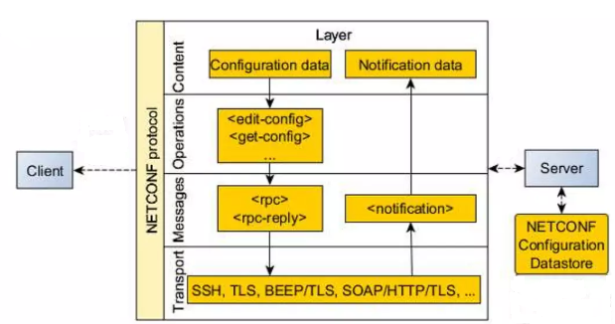
Network Configuration Protocol Layers
25.<number>

Slide 52
Network Configuration Protocol
The NETCONF protocol is built on a 4-layer approach:
Secure Transport Layer: Authentication and Integrity can be provided by protocols such as TCP based TLS and SSHv2.
Message Layer: A set of RPC messages and notifications are defined for use including <rpc>, <rpc-reply>, and <rpc-error>
Operations Layer: Defines a set of base protocol operations invoked by RPC methods using XML encoding
Content Layer: NETCONF data models and protocol operations uses the client data.
25.<number>

Slide 53
Basic Features of NETCONF
Separates configuration and operation data
Client Server architecture
Implemented using layered model
Support multiple configuration data stores an managed devices
Configuration validation before commit
Transactions over multiple managed devices
25.<number>

